Slide 1
Practicals multiblock analyses

Slide 2
Context and dataset introduction
library(CCA)
data("nutrimouse")
The dataset comes from a nutrigenomic study in the mouse (Martin et al., 2007, https://doi.org/10.1002/hep.21510) in which the effects of five regimens with contrasted fatty acid compositions on liver lipids and hepatic gene expression in mice were considered.
Objective: Investigate the impact of five diets with distinct fatty acid profiles on liver lipids and gene expression.
Design: 40 mice, cross-classified by:
Genotype: WT vs PPARα -/-
Diet: corn and colza oils (50/50) for a reference diet (REF), hydrogenated coconut oil for a saturated fatty acid diet (COC), sunflower oil for an Omega6 fatty acid-rich diet (SUN), linseed oil for an Omega3-rich diet (LIN) and corn/colza/enriched fish oils for the FISH diet (43/43/14)
Variables:
Gene expression: 120 selected genes (among about 30,000) as potentially relevant in the context of the nutrition study (macroarray)
Lipid composition: 21 hepatic fatty acids (GC analysis)

Slide 3
Unsupervised multiblock analysis - ComDim
Goals
Explore structure and variability in the complete multiomics dataset consisting of lipid and gene data.
Tasks
1. Data Preparation
Concatenate lipid and gene dataframes and define the
number of variables in each block.
2. ComDim Analysis
Run ComDim() from the MBAnalysis package.
3. Block Contributions
Plot saliences to assess how lipids and genes contribute to each dimension.
4. Sample Space Visualization
Plot scores on Dim.1 vs Dim.2 and Dim.3 vs Dim.4
Identify main sources of variation.
5. Variable Contributions
Plot loadings on Dim.1 vs Dim.2 and Dim.3 vs Dim.4
Highlight key genes and lipids driving sample differences.
library(MBAnalysis)
ComDim_res <- ComDim(X = ComDim_data,
block = n_group,
name.block = c("genes", "lipids"),
scale = T,
scale.block = T)
saliences <- ComDim_res$saliences
scores <- data.frame(metadata, ComDim_res$Scor.g)
ComDim_res$cumexplained[1,"%explX"]
loadings <- data.frame(ComDim_res$Load.g)

Slide 4
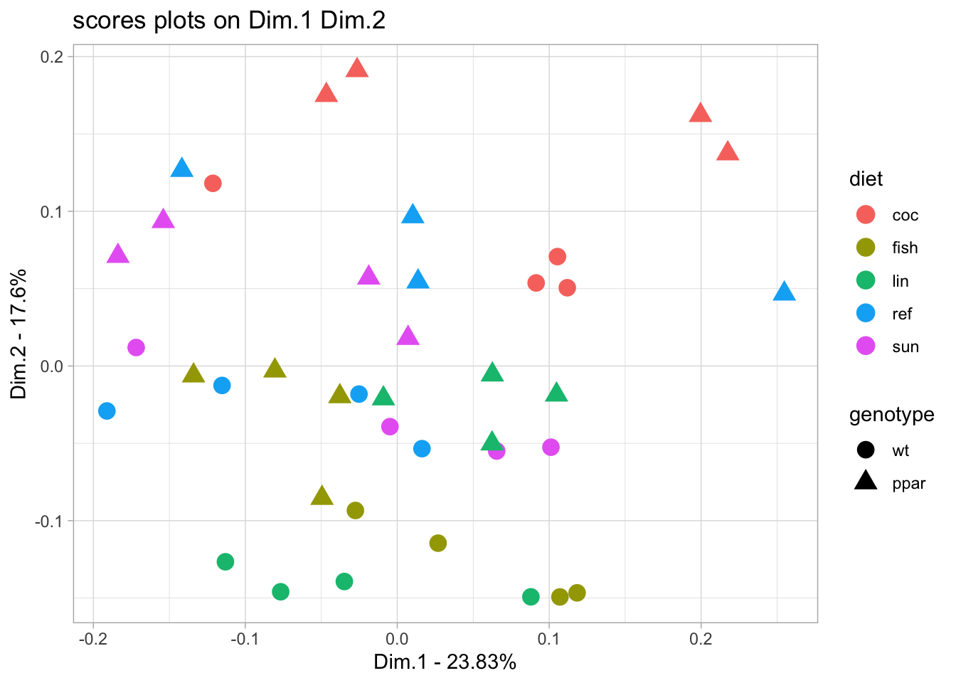
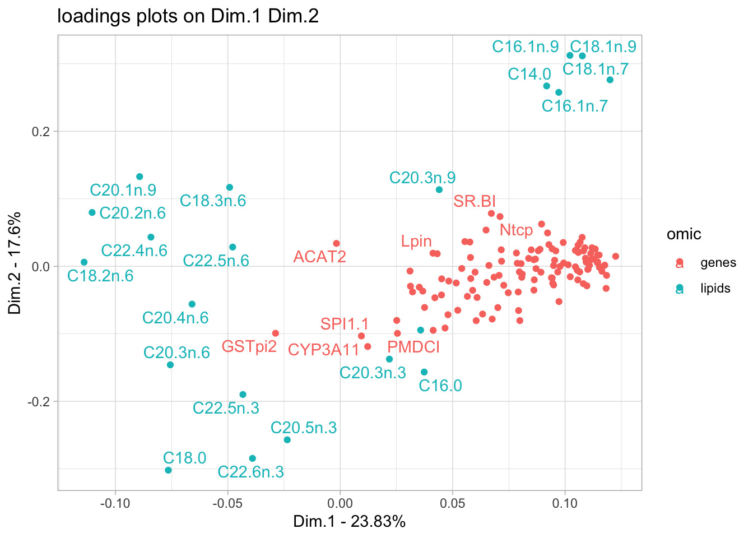
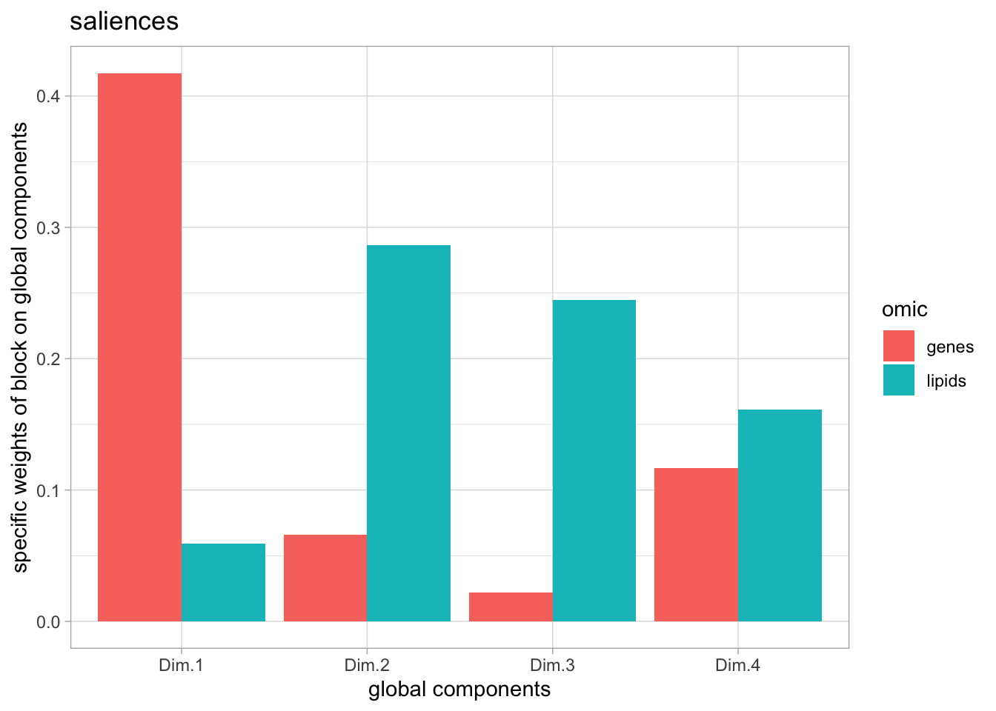
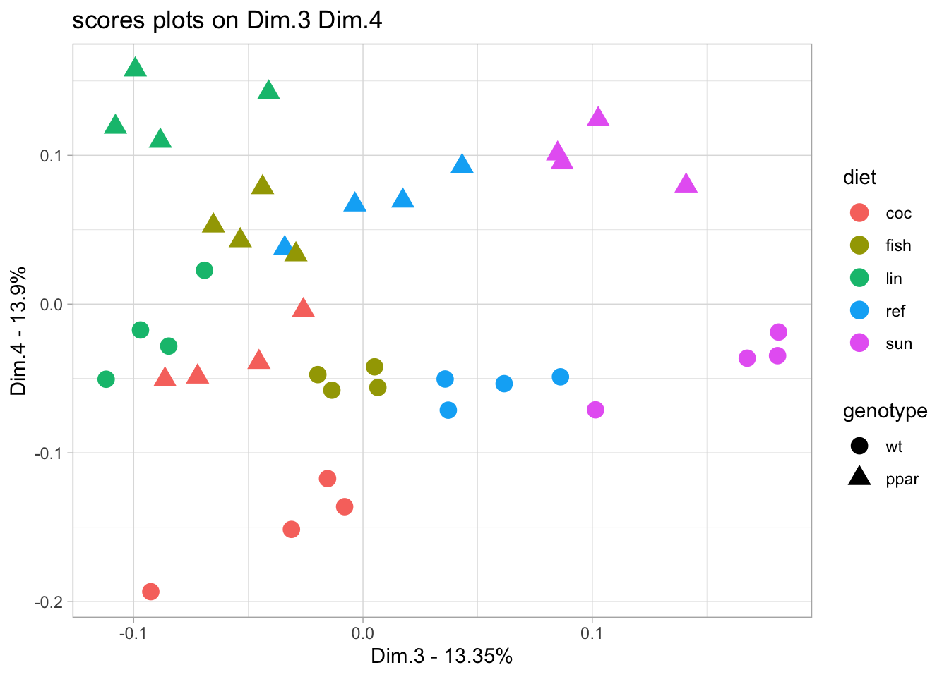
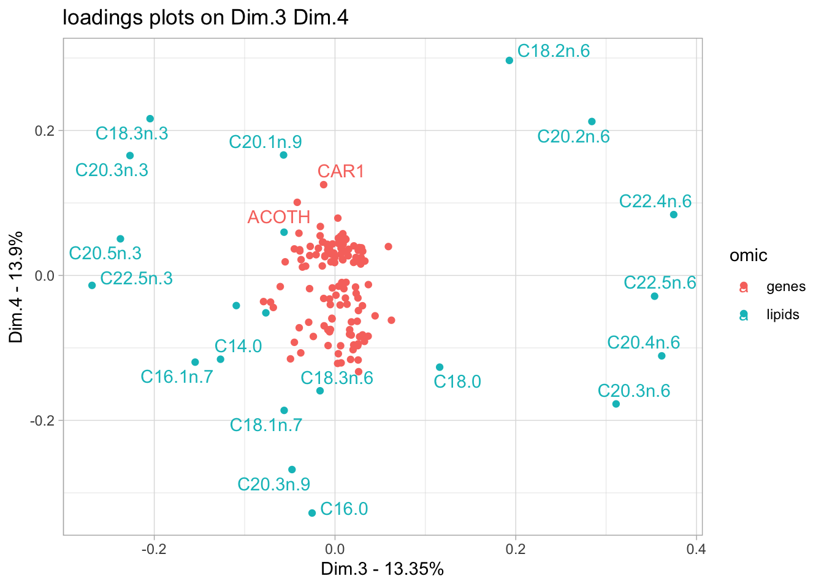
ComDim analysis of complete dataset

Slide 5
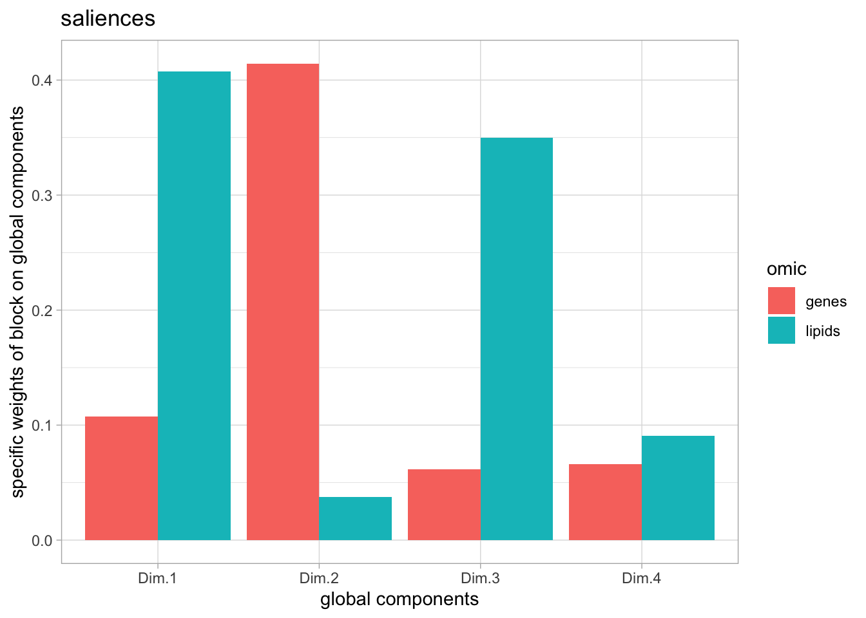
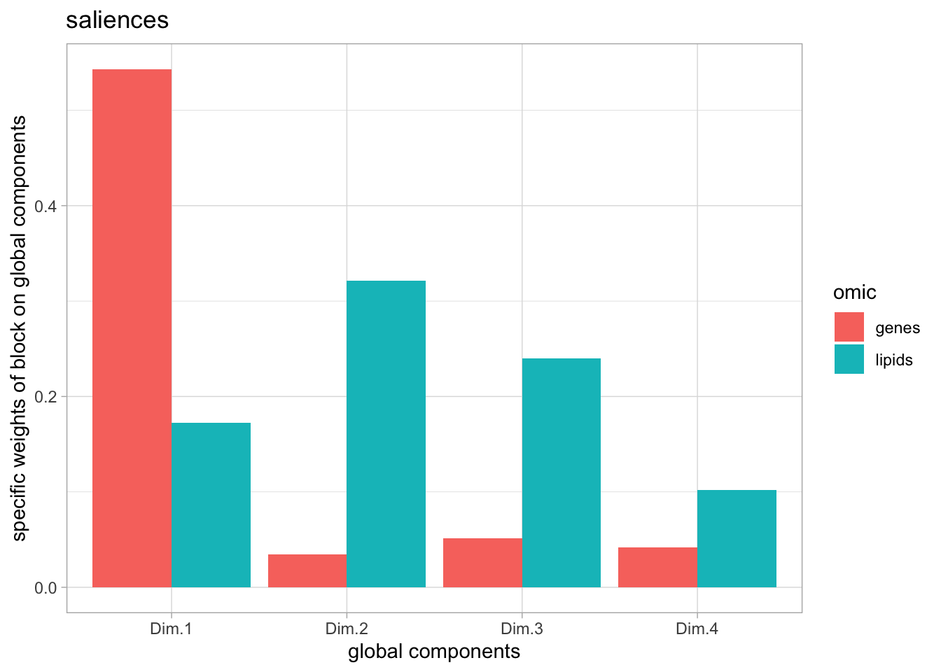
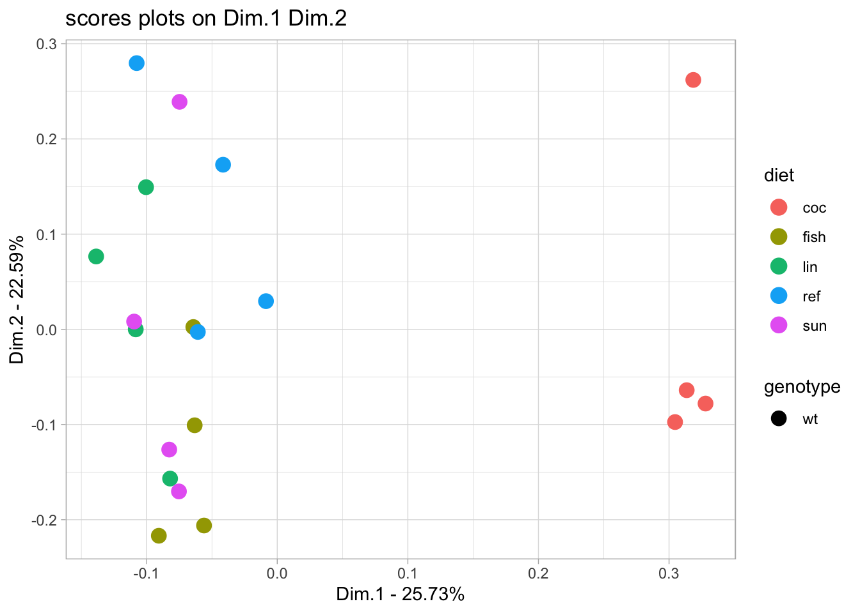
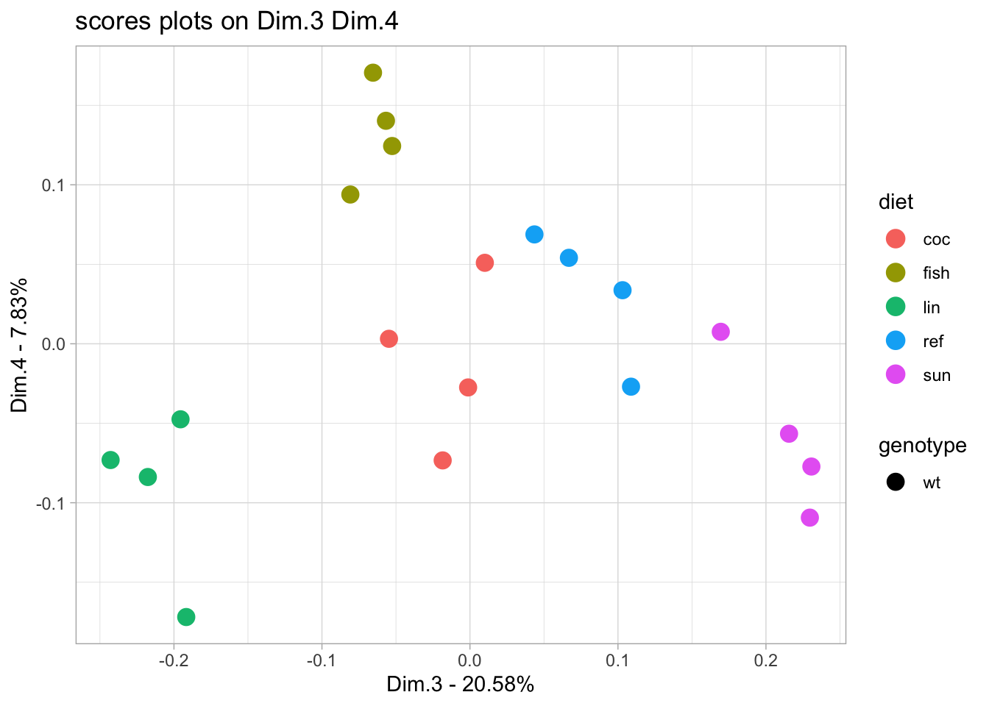
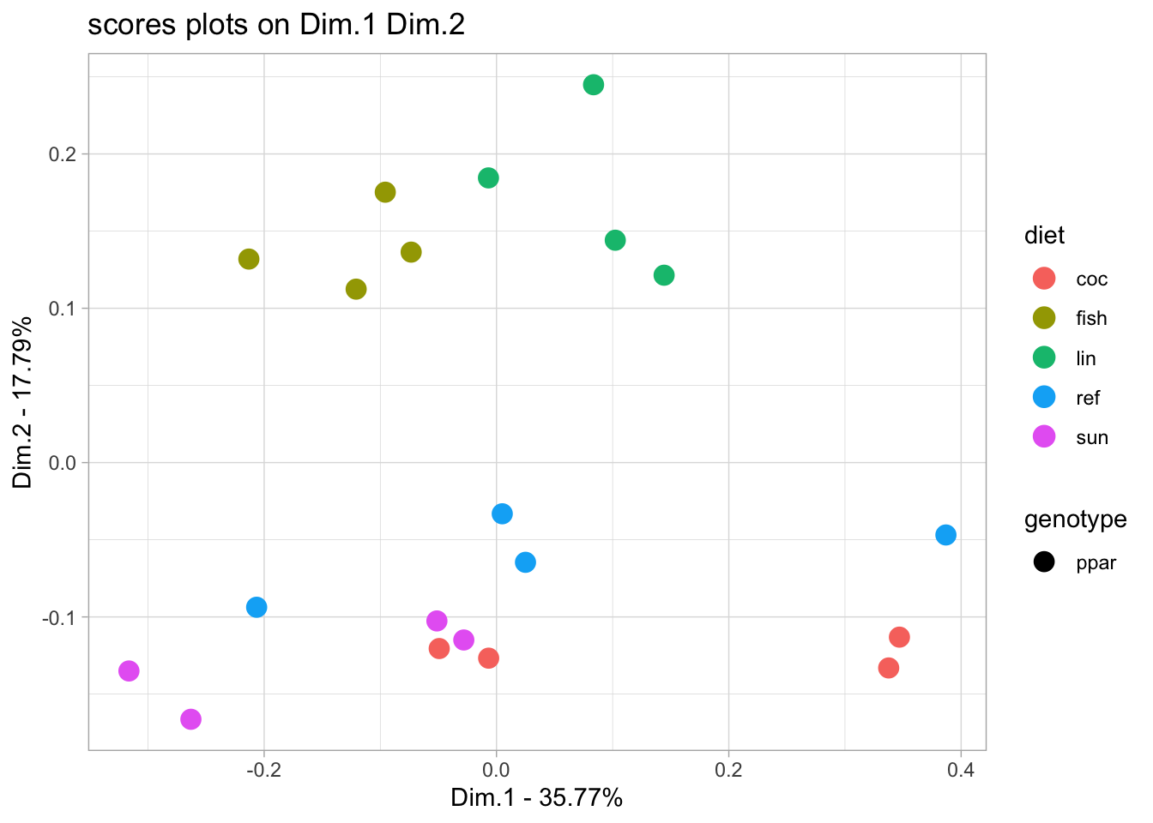
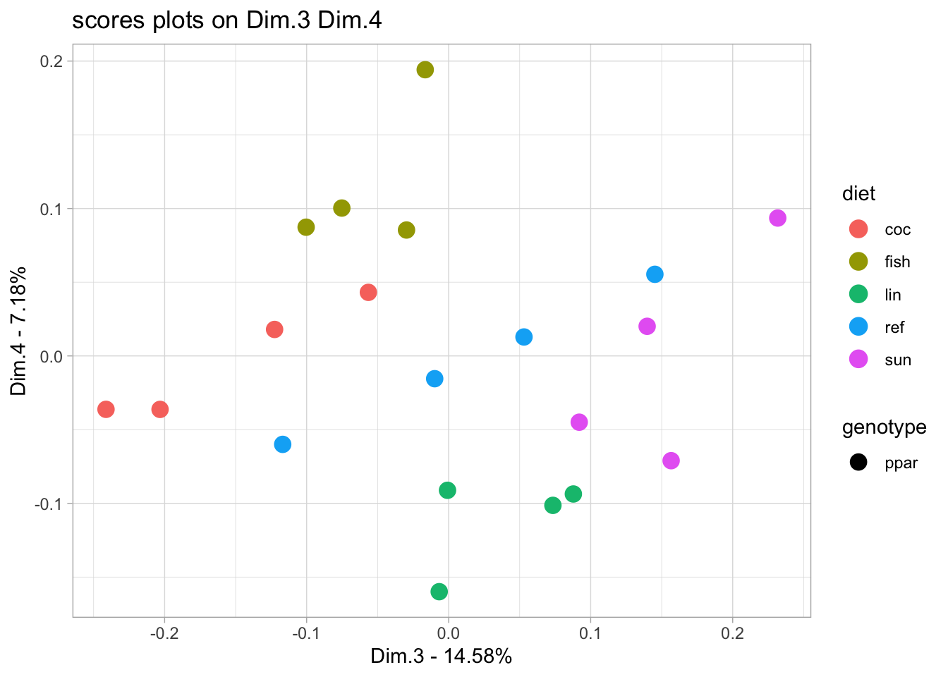
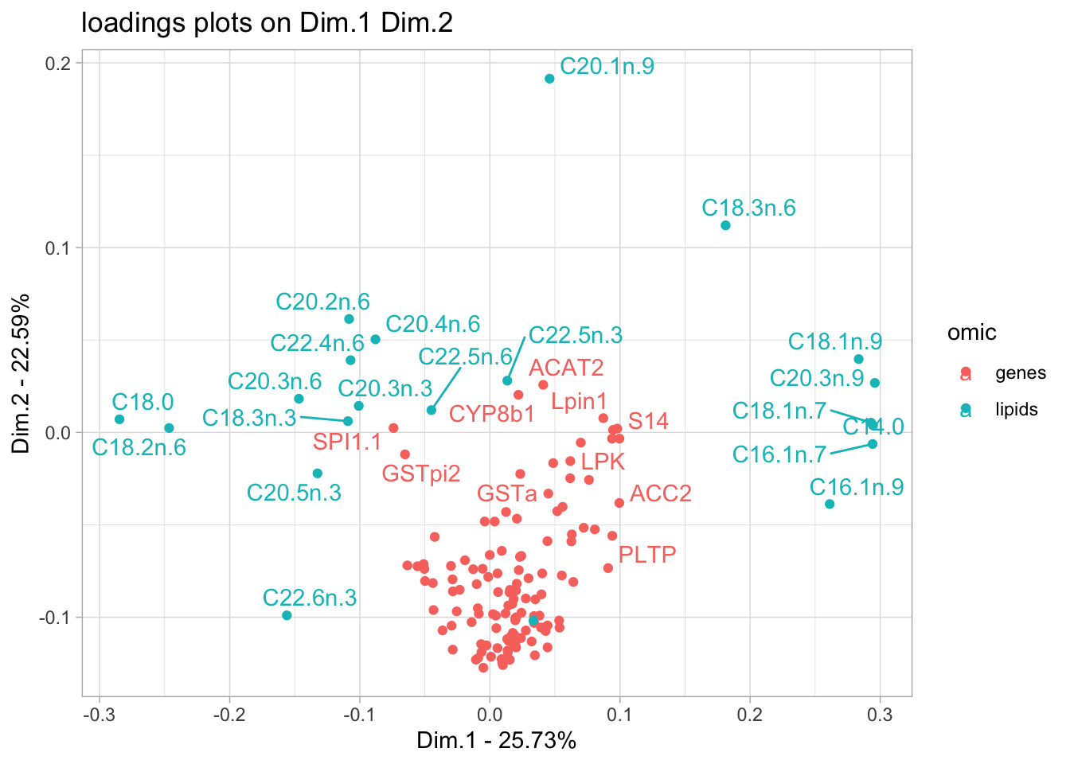
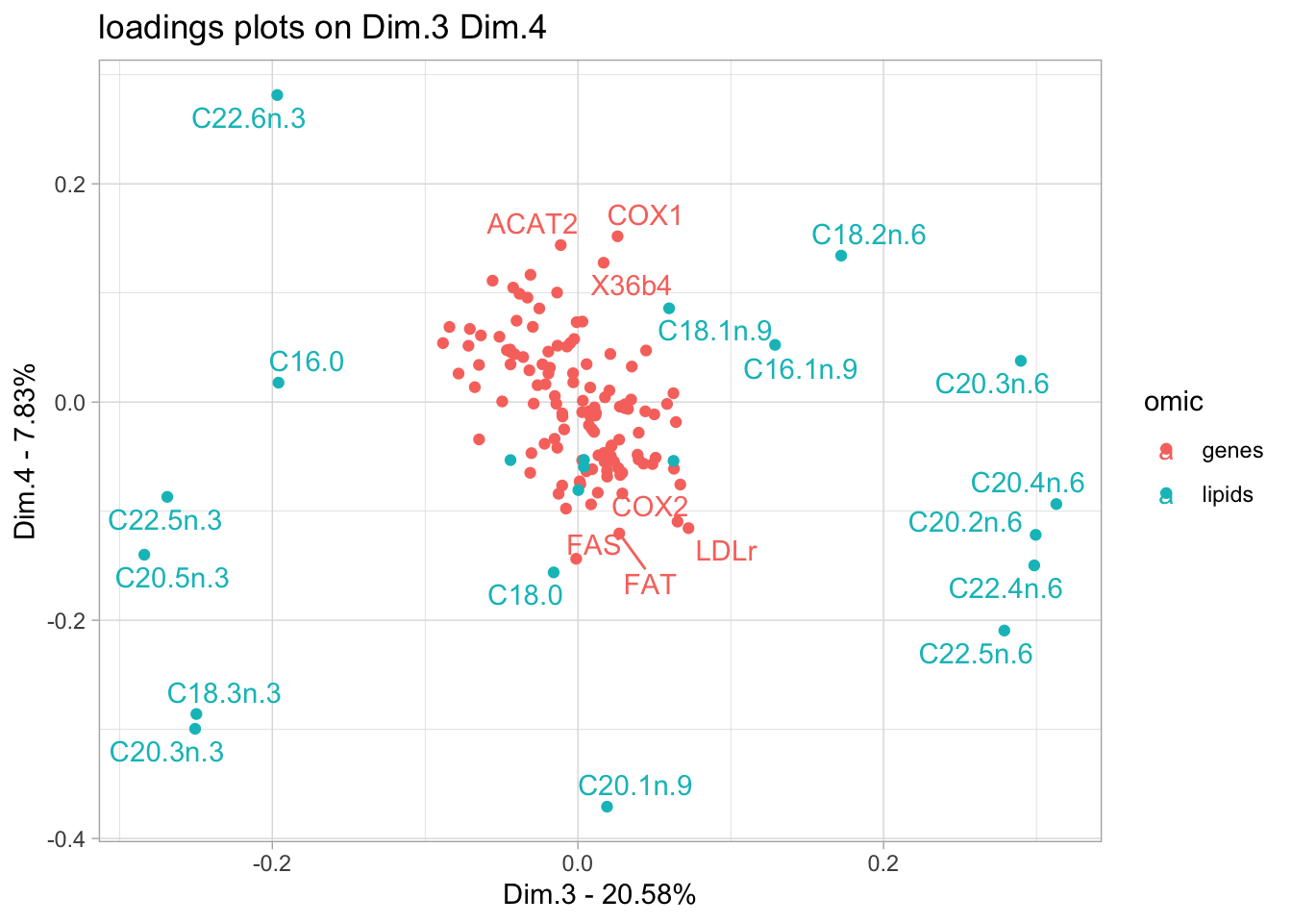
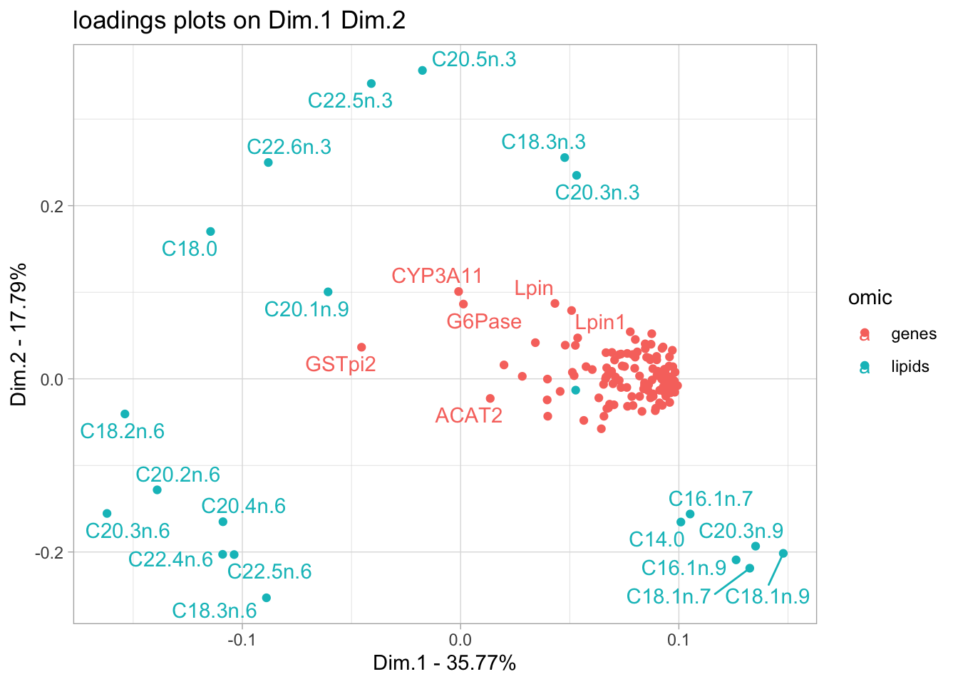
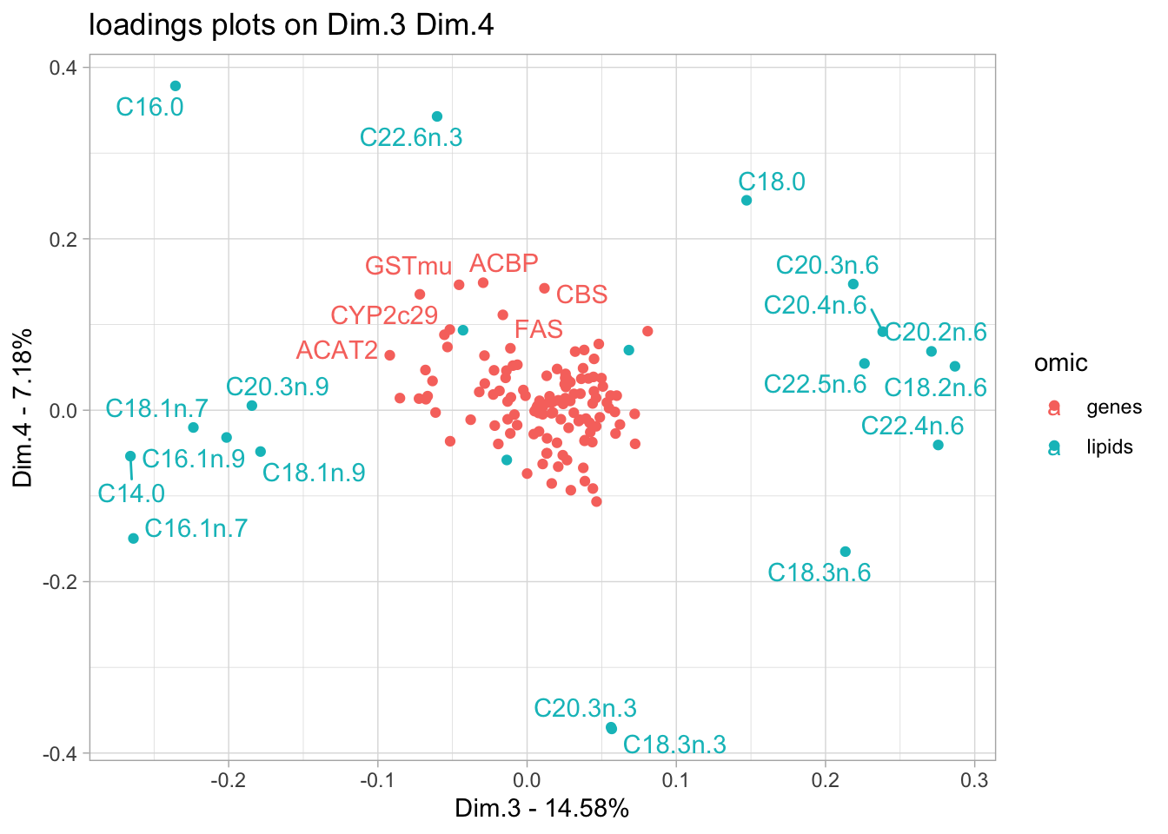
ComDim analysis of WT and ppar datasets

Slide 6
MBPLS Discriminant analysis wt vs ppar - mixOmics
Goals
Discriminate between WT and PPAR samples using integrated lipid and gene data.
Tasks
1. Data Preparation
Format lipid and gene data as a list of dataframes.
Define the outcome variable (genotype) as a factor.
2. Block PLS-DA Analysis
Run block.plsda() from the mixOmics package to model genotype discrimination.
3. Latent Variable Selection
Use perf() to evaluate model performance across components and visualise.
Re-run block.plsda() using the optimal number of latent variables.
4. Model Significance
Perform a cross-validation using DIABLO.cv() from the RVAideMemoire package
Perform a permutation test using DIABLO.test() from the RVAideMemoire package.
5. Explained Variance
Plot explained variance per block and globally across latent variables.
6. Sample Space Visualization
Use plotIndiv() to visualize sample distributions in latent variable space.
7. Variable Contributions
Use plotVar() to identify discriminant genes and lipids contributing to genotype separation.
block.plsda(X = blockPLS_data,
Y = genotype,
design = "full", all.outputs = T,
ncomp = 10)
perf(blockPLS_res, validation = 'Mfold', folds = 7, nrepeat = 10, auc = TRUE, cpus=2)
DIABLO.cv(blockPLS_res)
DIABLO.test(blockPLS_res)
blockPLS_res$AVE$AVE_X[1:2]
blockPLS_res$AVE[["AVE_outer"]]
plotIndiv(blockPLS_res, block ="weighted.average")
plotVar(blockPLS_res)

Slide 7
MBPLS Discriminant analysis wt vs ppar - mixOmics
2. Block PLS-DA Analysis
blockPLS_res <- block.plsda( X = blockPLS_data,
Y = genotype, design = "full",
all.outputs = T,
ncomp = 10 )
Specifies the connectivity between blocks in the MBPLS/DIABLO framework: which blocks should share information.
"full" means all blocks are connected, so the method maximizes covariance between all block pairs.

Slide 8
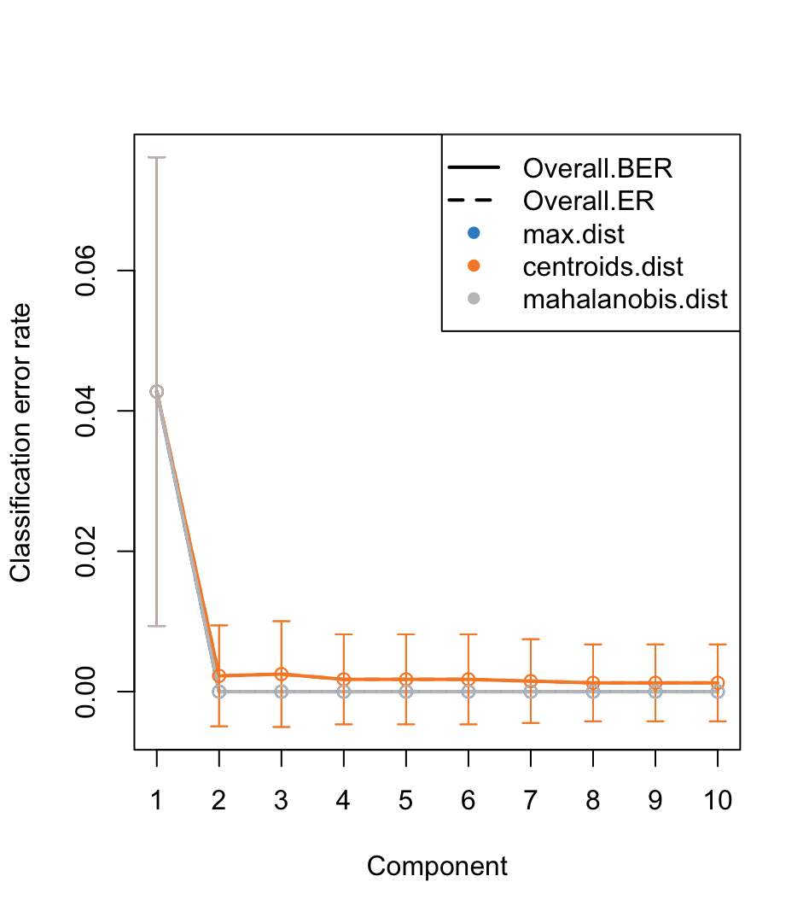
MBPLS Discriminant analysis wt vs ppar - mixOmics
3. Latent Variable Selection
4. Model Significance
Cross validation
Model: DIABLO
7-fold validation
Validation repeated 100 times
2 components
Classification criterion: Mahalanobis distance
Mean (standard error) classification error rate (%): 0.575 (0.015)
Permutation test based on cross-validation
data: blockPLS_res
DIABLO (2 components)
100 permutations
CER = 0.01375, p-value = 0.009901
CER: observed classification error rate
empirical p-value: the proportion of permutations where the permuted model achieved an equal or lower classification error rate than the real model.

Slide 9
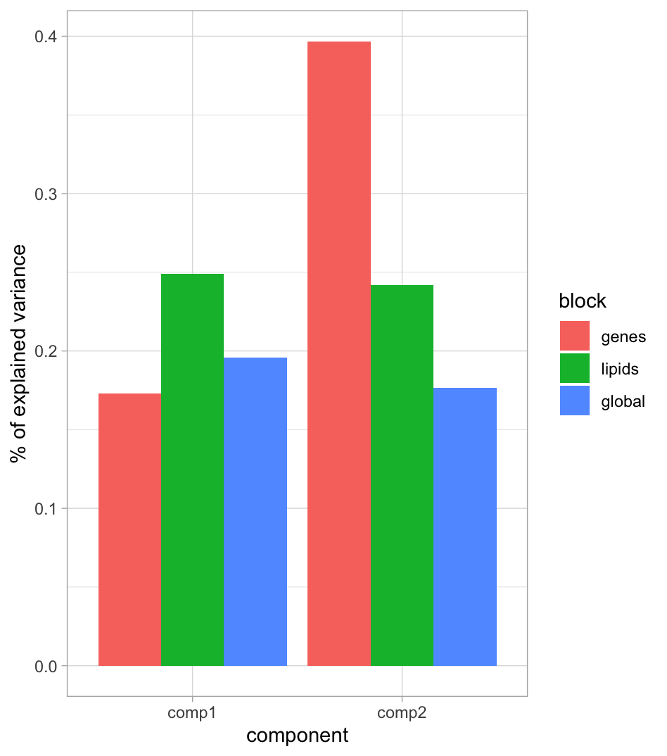
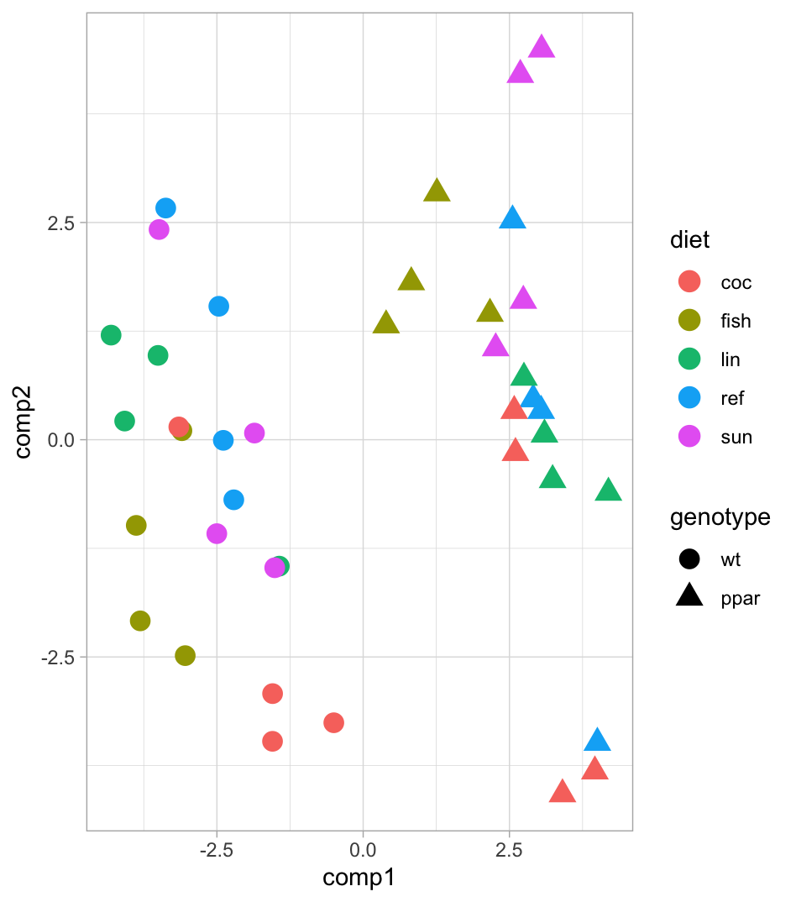
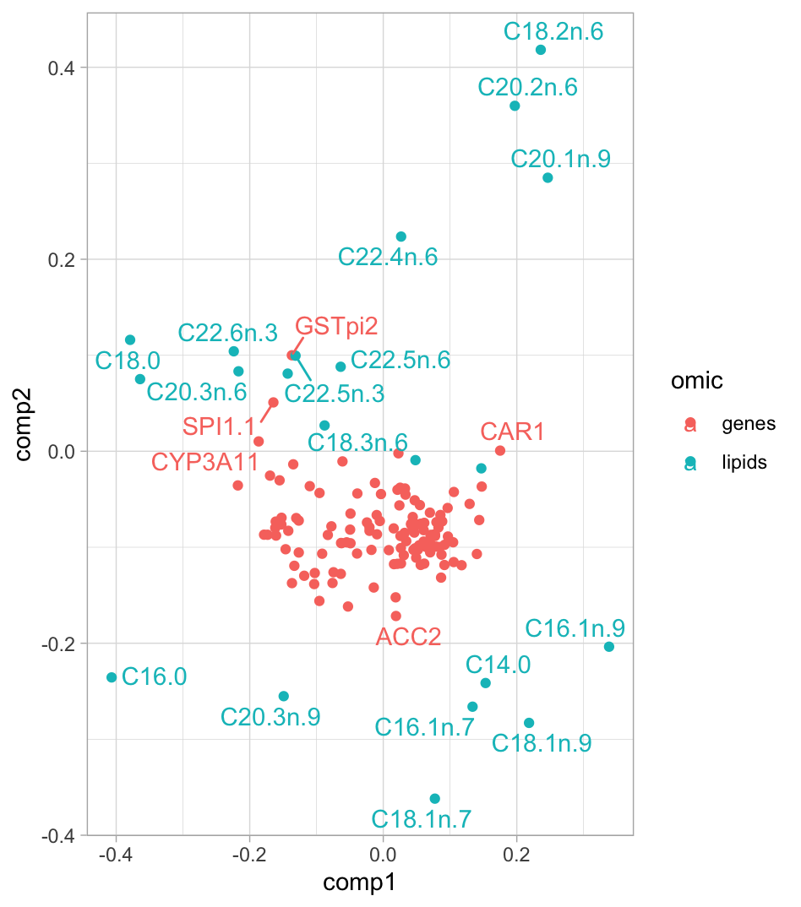
MBPLS Discriminant analysis wt vs ppar - mixOmics
5. Explained Variance
6. Sample Space Visualization
7. Variable Contributions

Slide 10

Summary MBPLS-DA mixOmics
Purpose: Reduce the dimensionality of multi-block, high-dimensional omics data while simultaneously modeling the relationship with a categorical outcome (e.g., disease status, genotype) preserving covariance between blocks.
How it works: MBPLS-DA constructs latent variables (LVs), which are linear combinations of variables in each block.
LVs are extracted sequentially: Each LV captures the maximal covariance with Y and across connected blocks. Blocks can be fully connected (design = "full") or selectively connected.
Key properties:
Supervised: Components maximize discrimination between predefined classes in Y.
Multiblock: Integrates information across multiple omics datasets, modeling both within-block variance and between-block covariance.
Latent variables are orthogonal within each block (depending on algorithm settings) and ordered by explained variance in relation to class separation.
Why use MBPLS-DA in omics:
Identify components that discriminate classes: Extracts latent variables that optimally separate experimental conditions, disease states, or genotypes.
Visualize class separation in multiblock space: score plots show how well classes are separated in the reduced space (supervised).
Identify variables contributing most to discrimination: Variable loadings per block highlight biomarkers or key features driving separation between classes.
Integrate multiple omics layers: Captures correlated features across blocks that jointly explain class variation.

Slide 11
Discriminant analysis wt vs ppar - consensusOPLS
Goals
Discriminate between WT and PPAR samples using integrated lipid and gene data.
Tasks
1. Data Preparation
Organize lipid and gene datasets as a list of dataframes (one per block).
Encode the outcome variable (genotype)
2. Consensus OPLS Analysis
Fit the Consensus OPLS model.
3. Model Significance
Assess statistical significance using permutation tests and visualize plotting
Q², dQ², and R²Y values from permuted models.
4. Block Contributions
Plot block contributions as a bar plot to see which omics layer drives genotype discrimination.
5. Sample Space Visualization
Plot scores to visualize sample distribution in the space of predictive and orthogonal latent variables.
6. Variable Contributions
Identify discriminant genes and lipids contributing to genotype separation plotting
loadings and VIP.
COPLS_res <- ConsensusOPLS(data = COPLS_data,
Y = genotype,
maxPcomp = 1,
maxOcomp = 1,
modelType = "da",
cvType = "nfold",
nfold = 5,
nperm = 100,
verbose = T)
plotQ2(COPLS_res)
plotDQ2(COPLS_res)
plotR2(COPLS_res)
plotContribution(COPLS_res)
plotScores(COPLS_res)
plotLoadings(COPLS_res)
COPLS_res$optimal$VIP

Slide 12
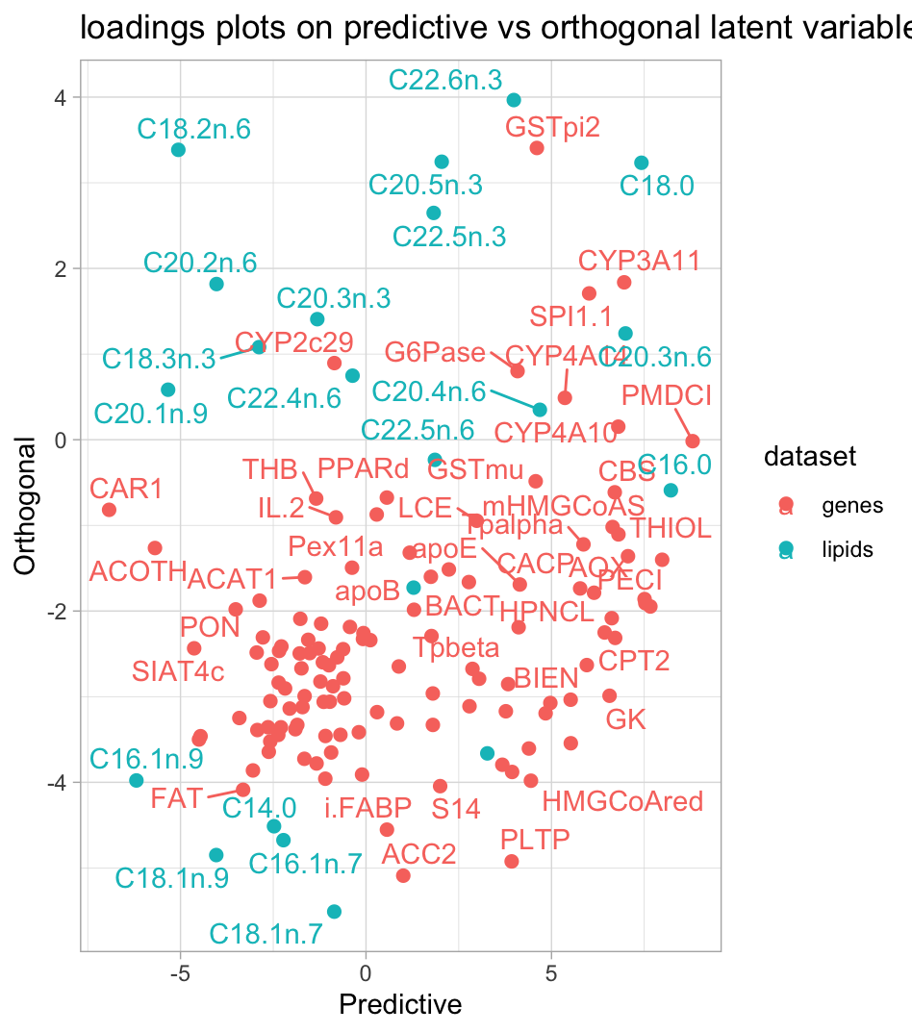
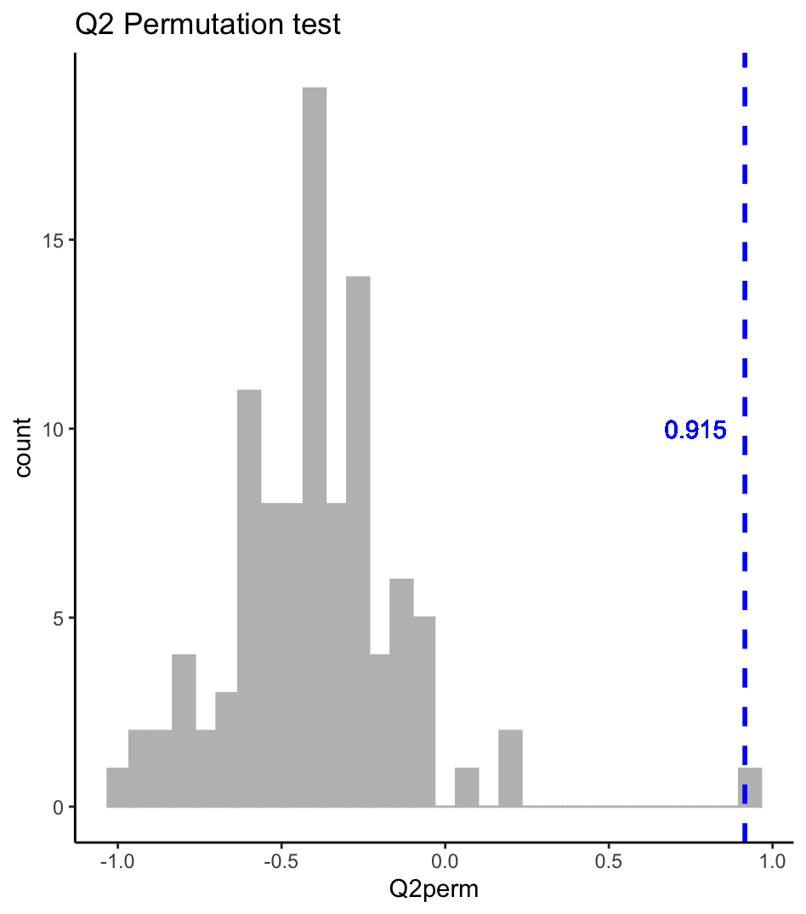
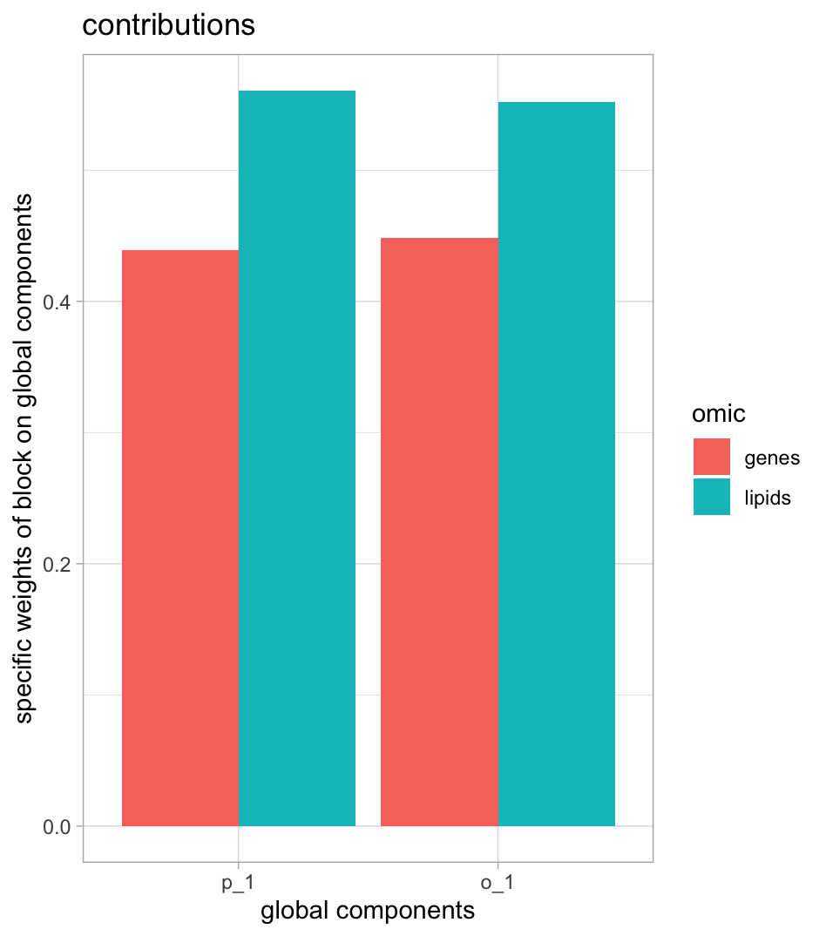
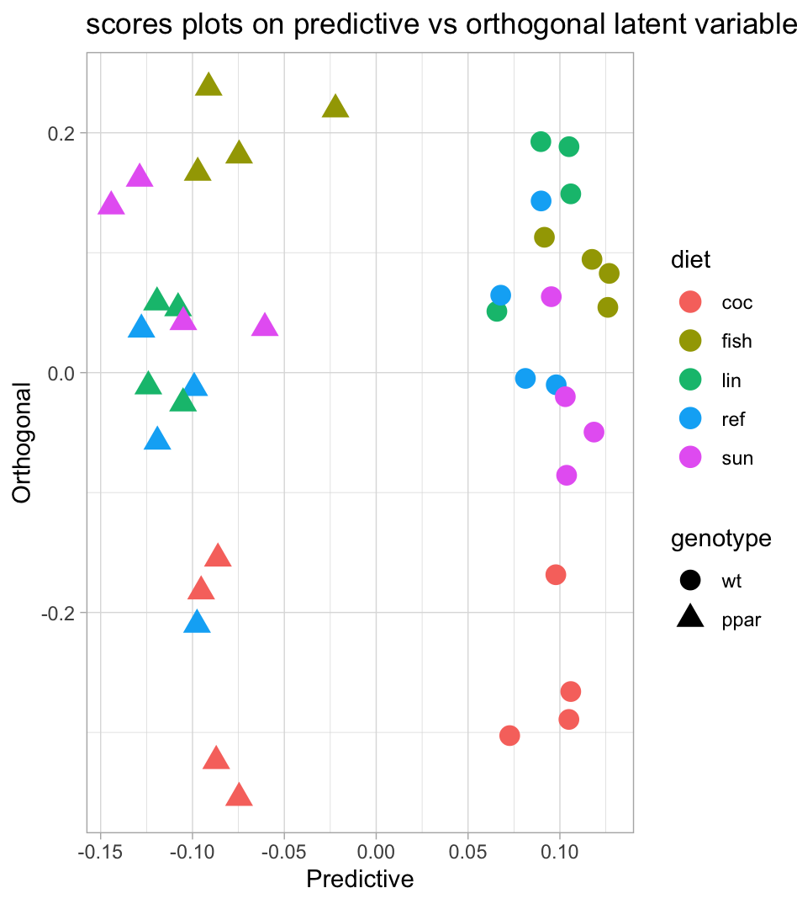
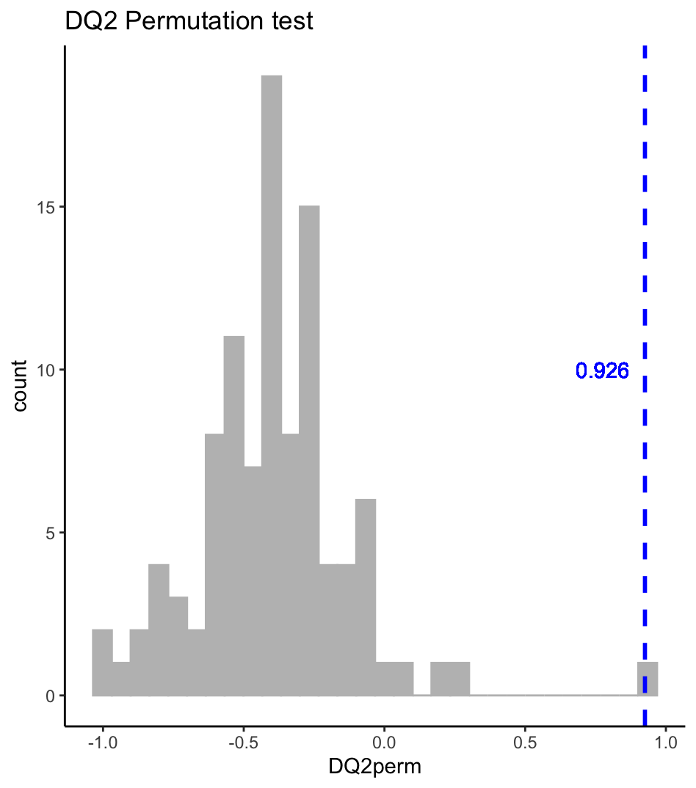
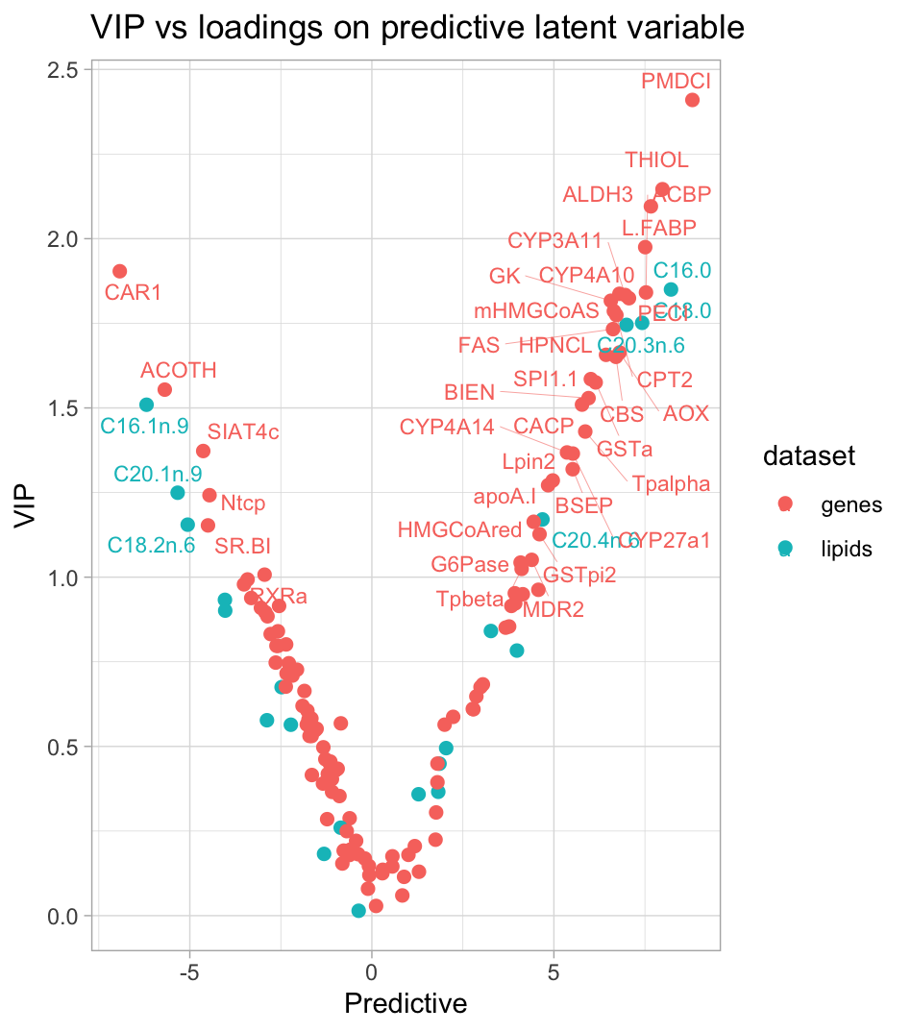
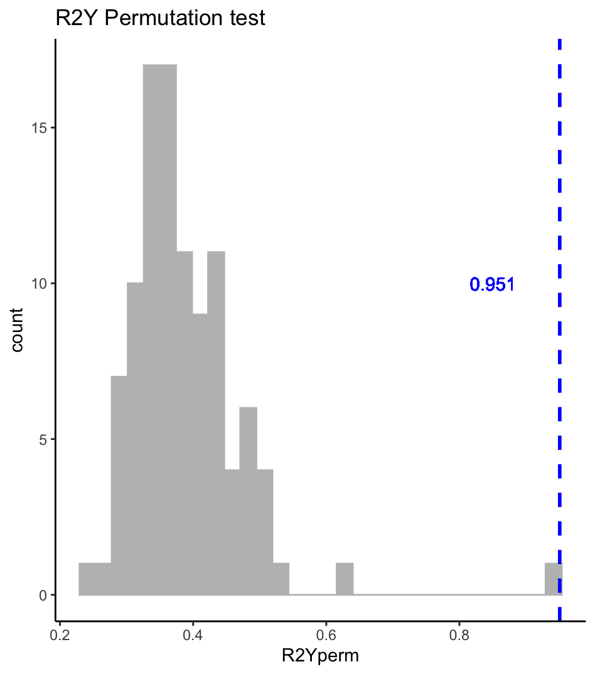
Discriminant analysis wt vs ppar - consensusOPLS

Slide 13
Predicting with consensusOPLS
Goals
Train a Consensus OPLS-DA model to discriminate between WT and PPAR samples using a training set and evaluate its performance on an independent test set.
Tasks
1. Data Splitting
Select 30 samples for training and 10 samples for testing.
Organize lipid and gene datasets as lists of matrices for training and testing.
Scale each block separately for training and test sets.
Define the outcome variable (genotype) for the training set.
2. Consensus OPLS Analysis
Fit the Consensus OPLS model on the training set.
3. Model Evaluation
Assess statistical significance using permutation tests and visualize plotting
Q², dQ², and R²Y values from permuted models. Observe block contributions, scores and loadings.
4. External Validation on Test Set
Predict class labels for the independent test samples using predict().
Compare predicted classes and predicted Y values against the true genotypes.
Summarize in a table for accuracy evaluation.
COPLS_res <- ConsensusOPLS(data = COPLS_data,
Y = genotype,
maxPcomp = 1,
maxOcomp = 1,
modelType = "da",
cvType = "nfold",
nfold = 5,
nperm = 100,
verbose = T)
plotQ2(COPLS_res)
plotDQ2(COPLS_res)
plotR2(COPLS_res)
plotContribution(COPLS_res)
plotScores(COPLS_res)
plotLoadings(COPLS_res)
COPLS_res$optimal$VIP

Slide 14
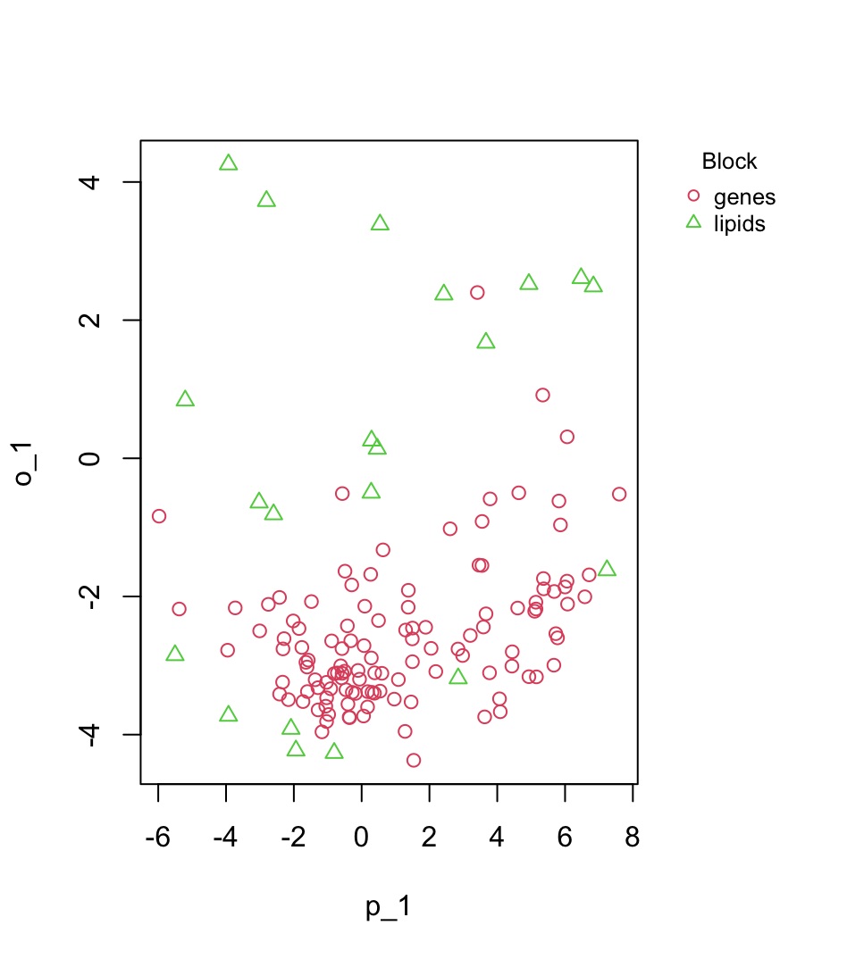
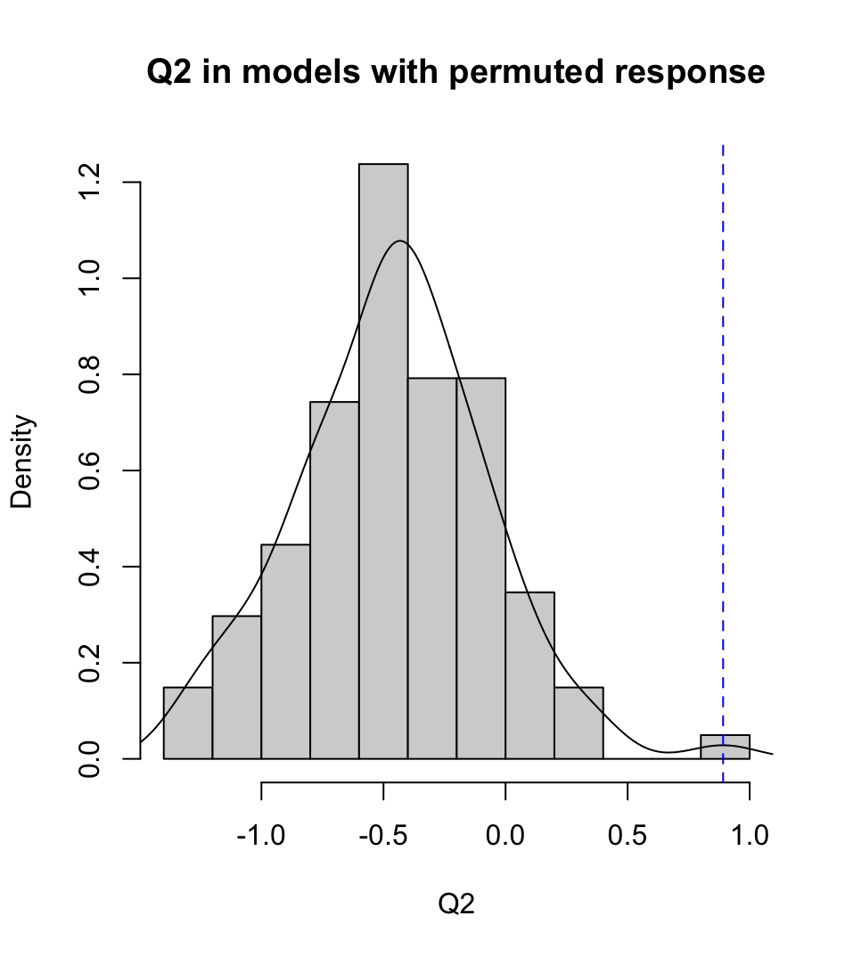
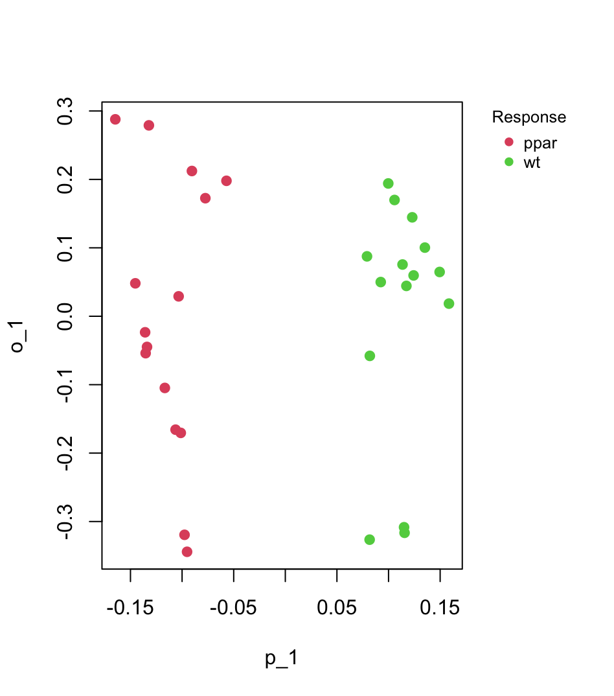
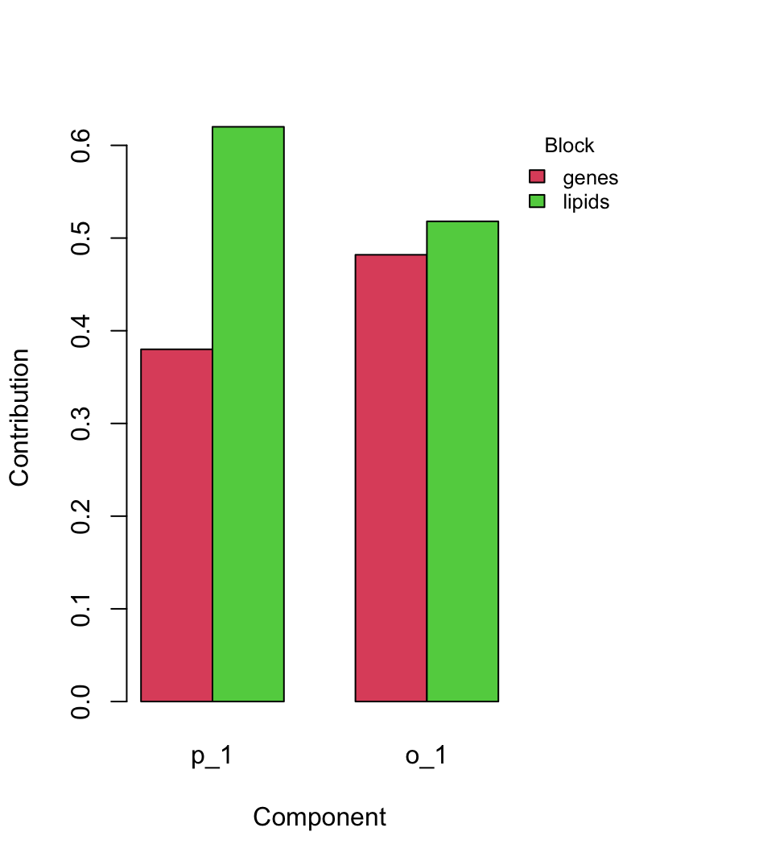
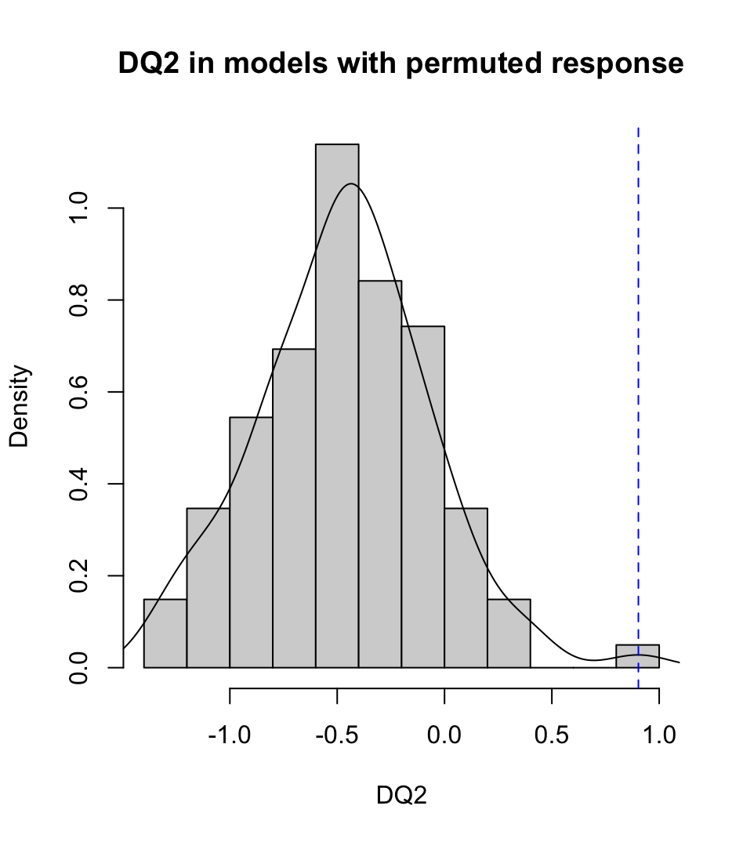
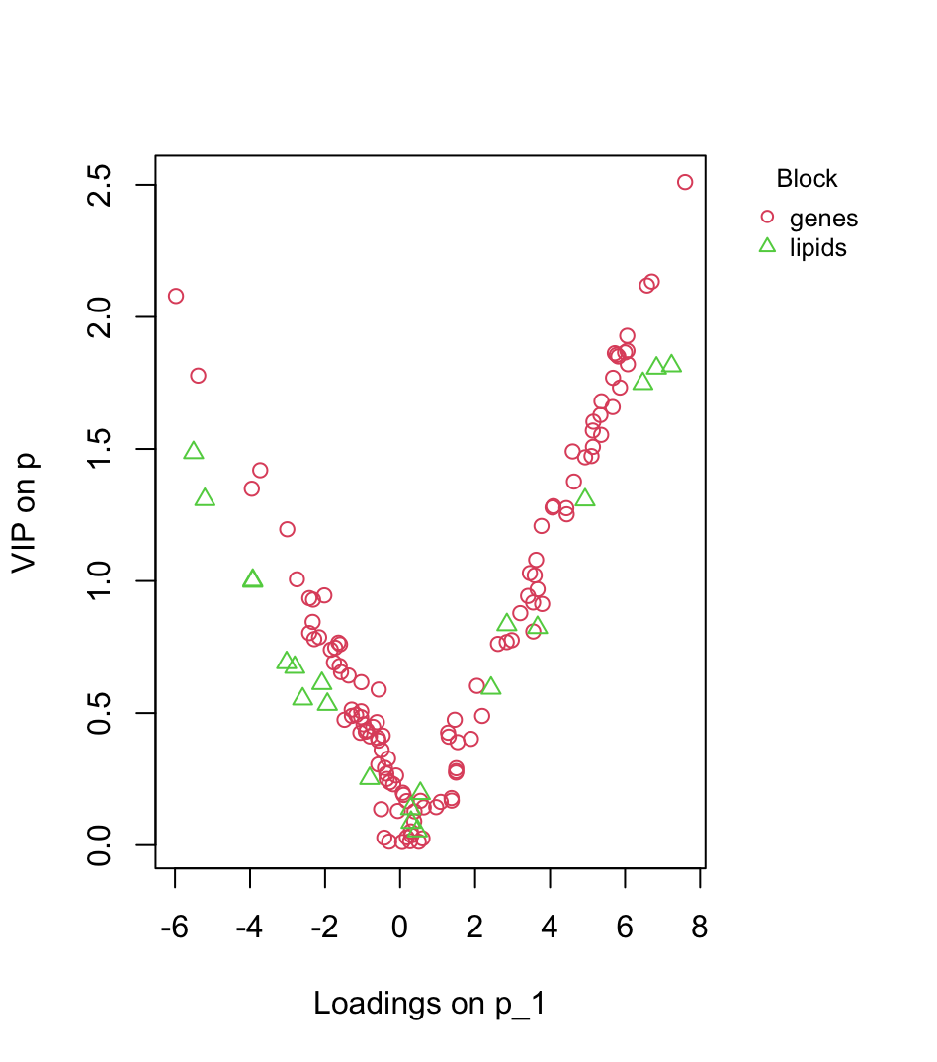
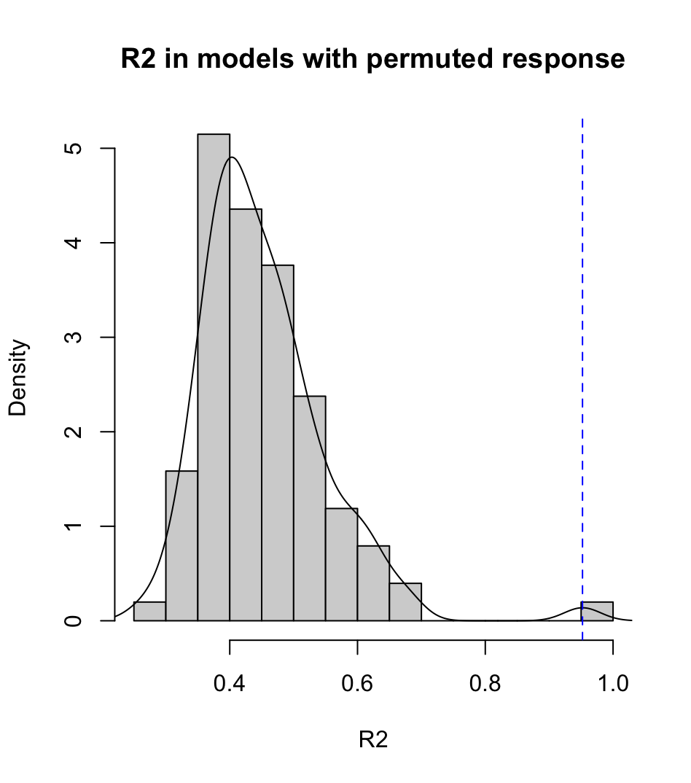
Predicting with consensusOPLS

Slide 15
Predicting with consensusOPLS
 | class <chr> | margin <dbl> | softmax.ppar <dbl> | softmax.wt <dbl> | Y.pred.ppar <dbl> | Y.pred.wt <dbl> | True.genotype <fctr>
8_wt_lin | wt | 2.0073085 | 0.000000 | 1.00000000 | -0.5036542 | 1.5036542 | wt
1_wt_lin | wt | 2.2077299 | 0.000000 | 1.00000000 | -0.6038649 | 1.6038649 | wt
11_wt_fish | wt | 2.7191952 | 0.000000 | 1.00000000 | -0.8595976 | 1.8595976 | wt
16_wt_lin | wt | 1.6347977 | 0.000000 | 1.00000000 | -0.3173988 | 1.3173988 | wt
17_wt_coc | wt | 1.6995590 | 0.000000 | 1.00000000 | -0.3497795 | 1.3497795 | wt
21_ppar_coc | ppar | 2.4374451 | 1.000000 | 0.00000000 | 1.7187225 | -0.7187225 | ppar
34_ppar_sun | ppar | 2.1653278 | 1.000000 | 0.00000000 | 1.5826639 | -0.5826639 | ppar
38_ppar_fish | ppar | 0.5705763 | 0.940192 | 0.05980796 | 0.7852882 | 0.2147118 | ppar
30_ppar_lin | ppar | 2.5939881 | 1.000000 | 0.00000000 | 1.7969940 | -0.7969940 | ppar
35_ppar_fish | ppar | 2.5012529 | 1.000000 | 0.00000000 | 1.7506264 | -0.7506264 | ppar
The probability that the sample belongs to each class
The actual genotype labels for the test samples.
The predicted class labels for each sample in the test set.
The predicted response values for each sample in each class.
The difference between the highest predicted score and the second-highest predicted score for a sample.

Slide 16
ConsensusOPLS - summary
Purpose: Reduce the dimensionality of multi-block, high-dimensional omics data while modeling the relationship with a categorical outcome (e.g., disease status, genotype), separating predictive variation from orthogonal variation and preserving covariance between blocks.
How it works: Consensus OPLS constructs latent variables (LVs): Predictive LVs capture variance in X blocks related to Y. Orthogonal LVs capture systematic variance in X blocks unrelated to Y.
LVs are extracted sequentially: Maximize covariance with Y (predictive) while modeling correlations across blocks.
Key properties:
Supervised: LVs explicitly maximize discrimination between predefined classes in Y.
Multiblock: Integrates multiple omics datasets, modeling both within-block variance and between-block covariance.
Separation of variance: Predictive vs orthogonal components clarify variance associated with outcome vs unrelated variance.
Why use MBPLS-DA in omics:
Identify components that discriminate classes: Extracts latent variables that optimally separate experimental conditions, disease states, or genotypes.
Identify discriminant variables: Loadings and VIP scores highlight genes or lipids driving class separation.
Integrate multiple omics layers: Captures correlated features across blocks that jointly explain predictive variance.
Predict new samples and use external validation.

